Slide 1

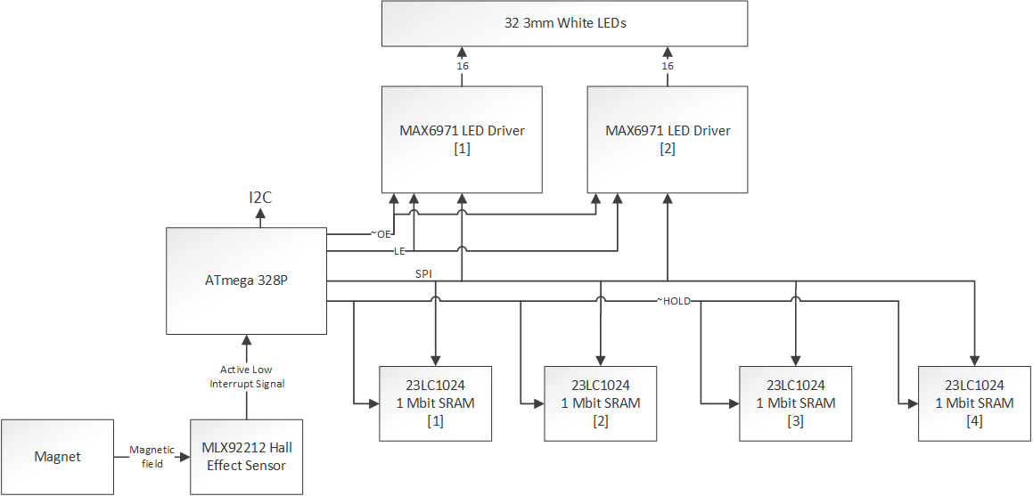
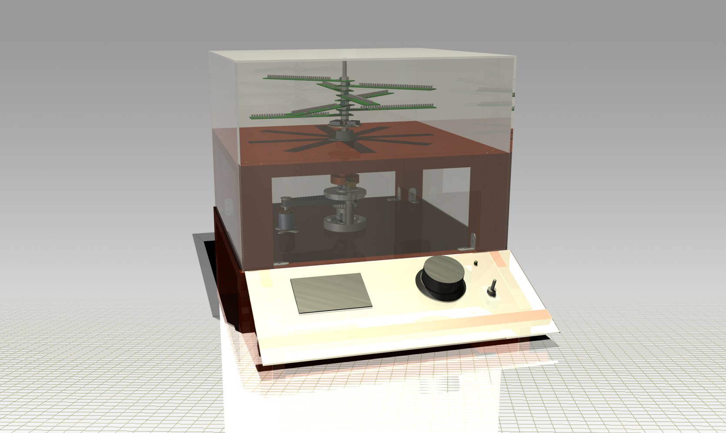
3DPOV Persistence of Vision Display
Philip D. Geramian, Alexander Julian, Roman Olesh, Lyle J. Moffitt
EECS Department, Syracuse University College of Engineering & Computer Science
Overview
Hardware Description
Engineering Challenges
The 3DPOV display is a three dimensional display that enhances 3D printing workflows by providing an organic representation of any 3D model. The system exploits the persistence of vision effect to form a perceived static image from layered motion (similar to how a spinning fan blade appears as a flat disc).
Layered segments of pulsing LEDs spin around a central shaft at 1800 rpm. The LEDs’ illumination is synchronized with specific points in the blades’ rotation to create the appearance of a 3D image.
An ATmega 328p microcontroller with an Arduino bootloader is used on each wing to handle all the data flow. A hall effect sensor acts as a unipolar digital switch and produces an active low signal when it passes over a magnetic field. This allows the rotations to be synced to a single point. Images and animations can be stored on the four Microchip 23LC1024 1Mbit SRAMs. In order to display images to the LEDs, we interface to them with two Maxim MAX6971 LED driver IC’s. Both the LED driver and the SRAMs communicate via an SPI interface.
It was a difficult journey to turn the 3DPOV display into a cohesive, functioning device. We had very tight constraints on our data paths which required us to carefully plan out the hardware and software design. Components were tested to ensure optimal integration with the system.
Additionally, determining a feasible method of supplying the rotating system with continuous power was difficult due to the sheer power draw of all eight blades. In a worst case scenario, the boards could draw close to 6 Amps of current. The power supply and cabling system was designed and chosen with these constraints in mind.
The final major challenge was keeping the system well balanced. Even a small amount of play in the shaft could cause issues. We chose a double helix formation with the blades to get a well balanced system. Additionally, a bearing was attached to the upper layer to counteract any play in the lower shaft mechanisms.
Mechanical Description
The 3DPOV display is driven by a 750 KV DC brushless motor that spins at 5400 RPM. The motor is controlled using a 30A electronic speed controller (ESC). The knob located on the control panel adjusts the speed and an Arduino Pro Mini interfaces to the speed controller. We use a 1:3 timing belt configuration to connect the motor to the main shaft, giving us more torque and reducing the speed to 1800 RPM (30 Hz).
The shaft is coupled to a carriage bolt that allows us to secure the 8 blades to the shaft. In order to balance the system, the 8 blades form a double-helix formation. Additionally, a bearing is mounted to the upper wood platform to compensate for any play in the lower shaft.
Conclusion
Ultimately we were successful in implementing our design goals. We were successful in: being able to have a stable system with minimized vibrations at our targeted operating speed, the ability to control all of our LEDs across all of our eight boards, and having a presentable project.
In the end, this turned out to be a very suitable choice in design project as it brought together a multitude of our skills that we have gained over the past years.
Software Description
BeagleBone (Front End)
Data flow control is primarily segmented into two phases: load-up and run-time.
Load-up: (left)
3D image source is pre-processed, divided by layer, and serialized as flat arrays before being transferred to the display. On receipt, the data is stored as a look-up table (LUT), indexed by theta position.
Run-time: (right)
While the blades are spinning, the MCUs execute an interrupt-driven, asynchronous REPL. The LUT is read from SRAM, and display state evaluation yields the current position’s state, which is printed to the LEDs before looping back again.
Arduino (Back End)
Import Source
Slice
Tool: Slic3r
Rasterize
Tool: Ghostscript
Source: Online
Type: application/vnd.ms-pki.stl
Type: image/svg+xml
Type: application/vnd.cups-raster
Transform
Cartesian to Polar
Scale Resolution to Match LEDs
Type: application/octet-stream
Transfer
SPI over RF
I2C to blades
Interrupt Source
Hardware Timer
I²C Tx/Rx
Load LUT From SRAM
Print LEDs From LUT
Select SRAM Source
Load SRAM
SPI Tx/Rx
Store SRAM
I²C Transfer
Reset Timer
Hall-Effect Sensor
Special Thanks to: Dr. Duane Marcy, Dr. Brandon Choi, Mr. William Tetley, Mr. Michael Frasciello, Brandon Koehring, Mr. Timothy Breen, and Mr. John Bryant.
In Memory of: Christopher B. Budwey

